Slide 1
Angular basics
Pipes, Directives

Slide 2
Simple task
Get data, transform them, and show them to users.

Slide 3
Let’s try to complete it!
We got a data! (f.e. created local variable or fetched data from server)
We push raw data directly to the view, calling toString() method.
…
Done!

Slide 4
Smth went wrong...
We created new Date object and we saw this:
Fri Apr 15 1988 00:00:00 GMT-0700 (Pacific Daylight Time)
But we wanted smth like this..:
April 15, 1988

Slide 5
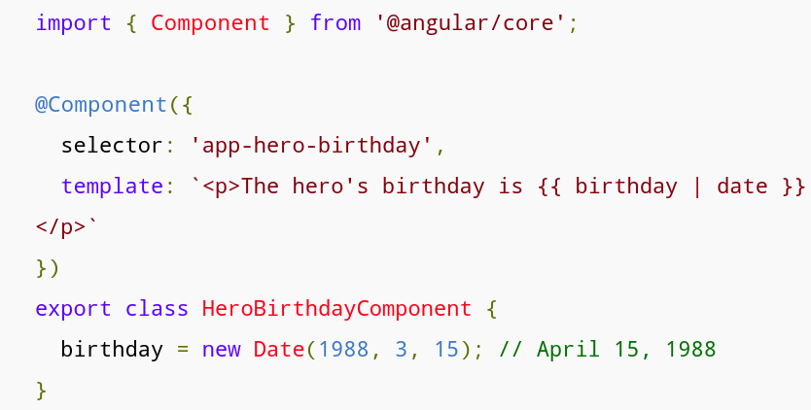
Here comes the Pipe

Slide 6
Built in pipes
DatePipe
UpperCasePipe
LowerCasePipe
CurrencyPipe
PercentPipe

Slide 7
PIPES DEMO

Slide 8
Directives
Components – directive with a template
Structural directives – change the DOM layout by adding and removing DOM elements
Attribute directives – change the appearance or behavior of an element, component, or another directive

Slide 9
Examples
Structural directives – NgIf, NgFor
Attribute directives – NgStyle, NgClass

Slide 10
DIRECTIVES DEMO

Slide 11
Q&A

